Slide 1
Natural Language Processing (NLP)
By TALHA AHMED

Slide 2
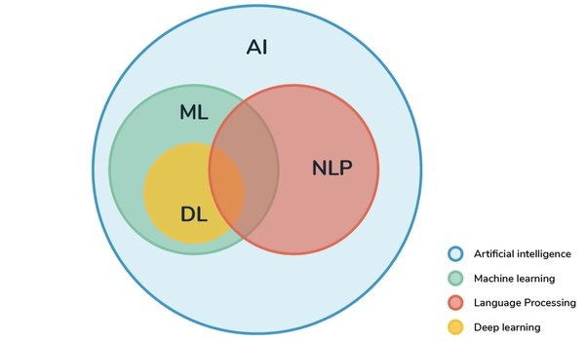
What is Natural Language Processing (NLP)
NLP is a field of AI focused on the interaction between computers and humans through natural language.
It involves analyzing, understanding, and generating human language using machine learning and linguistic rules.

Slide 3
Why Use NLP, Not Other Programming Languages?
Traditional programming languages handle structured data.
NLP allows machines to understand unstructured data like text and speech, which is more natural for human interaction.
NLP bridges the gap between machine and human communication, enabling more intuitive interfaces (chatbots, virtual assistants).

Slide 4
Categories of NLP
Syntax & Parsing : Analyzing sentence structure.
Semantics : Understanding meaning.
Pragmatics : Understanding context.
Morphology : Study of word structure and form.
Phonology : Sound structure of speech.
Discourse : Analyzing larger context in conversations.

Slide 5
Applications of NLP
Chatbots and virtual assistants.
Machine translation (Google Translate).
Sentiment analysis in social media
Text summarization.
Speech recognition.
Automatic content generation (e.g., GPT models).
Healthcare data analysis.

Slide 6
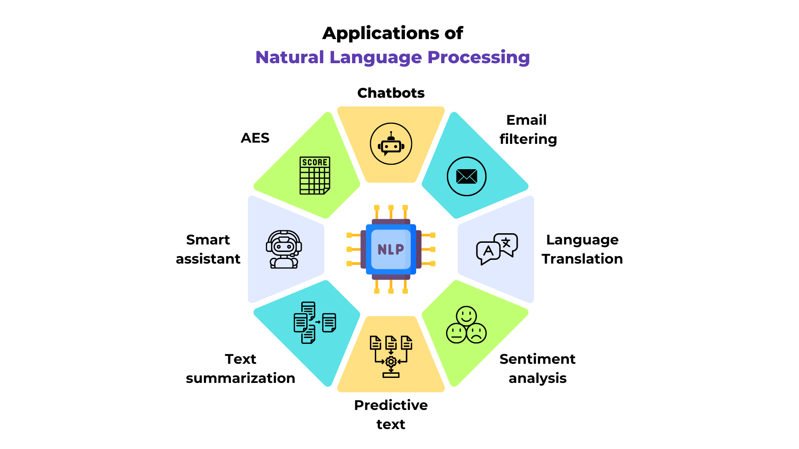

Slide 7
NLP Workflow Flowchart
1. Input: Raw text data.
2. Text Preprocessing: Tokenization, stemming, lemmatization, stop word removal etc
3. Feature Extraction: Bag of Words, TF-IDF, Word Embeddings.
4. Modeling: Using ML models (Logistic Regression, SVM, Neural Networks).
5. Evaluation & Output: Accuracy, sentiment scores, text generation.

Slide 8
Challenges in NLP
Ambiguity and Polysemy: Words with multiple meanings can cause confusion and incorrect interpretations depending on their usage.
Context Understanding: Properly interpreting text requires understanding the broader situation or context, which can be complex and varied.
Handling Diverse Language Variations: Variations in language use, including regional differences and informal expressions, complicate consistent text analysis.
Sarcasm and Sentiment Nuances: Identifying subtle emotional cues like sarcasm and nuanced sentiments is challenging due to their reliance on context and tone.
Data Privacy and Bias: Protecting personal data and preventing biases in training data are essential to ensure fairness and ethical practices in NLP.

Slide 9
Solutions to Common NLP Problems
Advanced models (Transformers like BERT, GPT) for better understanding of ambiguity.
Sarcasm detection with contextual learning and more labeled data.
Word sense disambiguation using embeddings and attention mechanisms.
Language models trained on diverse datasets for handling multiple languages.
Context-aware models such as long-form transformers.
Coreference resolution models using neural networks.
Custom NER models for domain-specific use cases.
Sentiment analysis improvements with fine-tuned datasets.
Few-shot learning for handling low-resource domains.
Efficient computing using model optimization techniques (distillation, quantization).

Slide 10
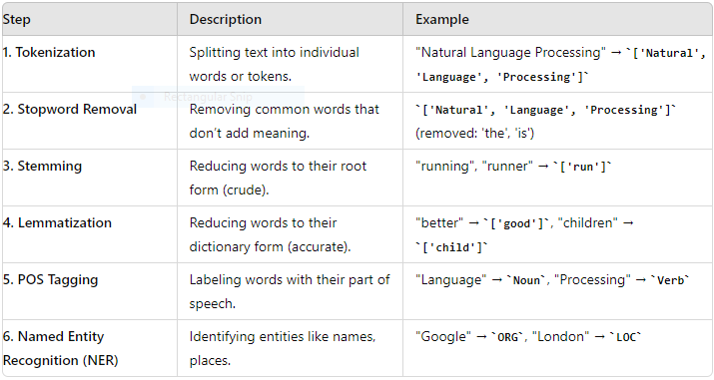
1 : TEXT PREPROCESSING

Slide 11
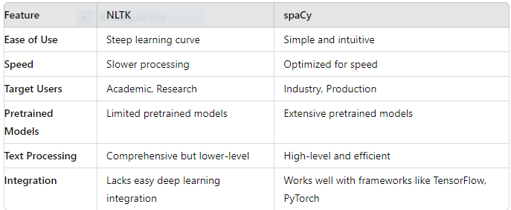
NLTK vs SPACY

Slide 12
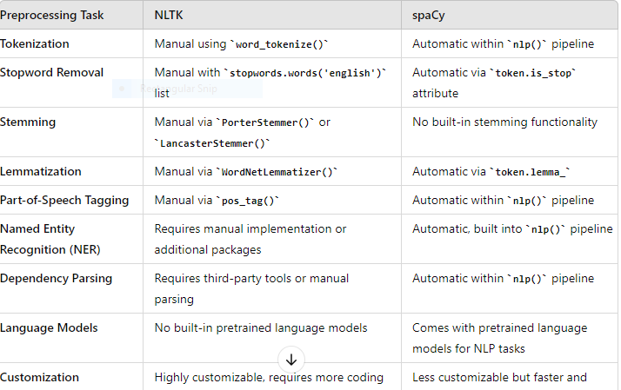
Comparison of Preprocessing Tasks: NLTK vs. SPACY

Slide 13
Lets Have some code
https://www.kaggle.com/code/talhaahmed9090/text-preprocessing-using-spacy

